Slide 1
Socially Responsible Investing (SRI):
Presentation 2
Instructor: Professor Henry Wong
Members Presenting:
Naga Sai Kiran Nimmakayala- U01823114
Farhan Mohammed - U01819625
Samarth Yadav - U01815170
Harshal Patil - U01825722
Kush Shah - U01788010
Jephthe Louis-Jacques - U00563103
Notes:
Louis-Jacques

Slide 2







Technology Stack
Project Management: JIRA
IDE: Visual Studios (Python)
Backend: GCP (Google Cloud Platform)
Front End: HTML , CSS, Angular/react TBD
APIs: Postman
Visualization Tool: Power BI or Tableau
White Boarding : Miro
Notes:
Samarth

Slide 3
Problem Statement
To solve the problem of investing in a socially responsible company, by providing real-time data and a study about the companies revenue and expenditure in the past years and whether the company is currently making profit in the running year which is directly related to it's stock price that will it fall or rise in future and prompting the customer if it not socially responsible.

Slide 4
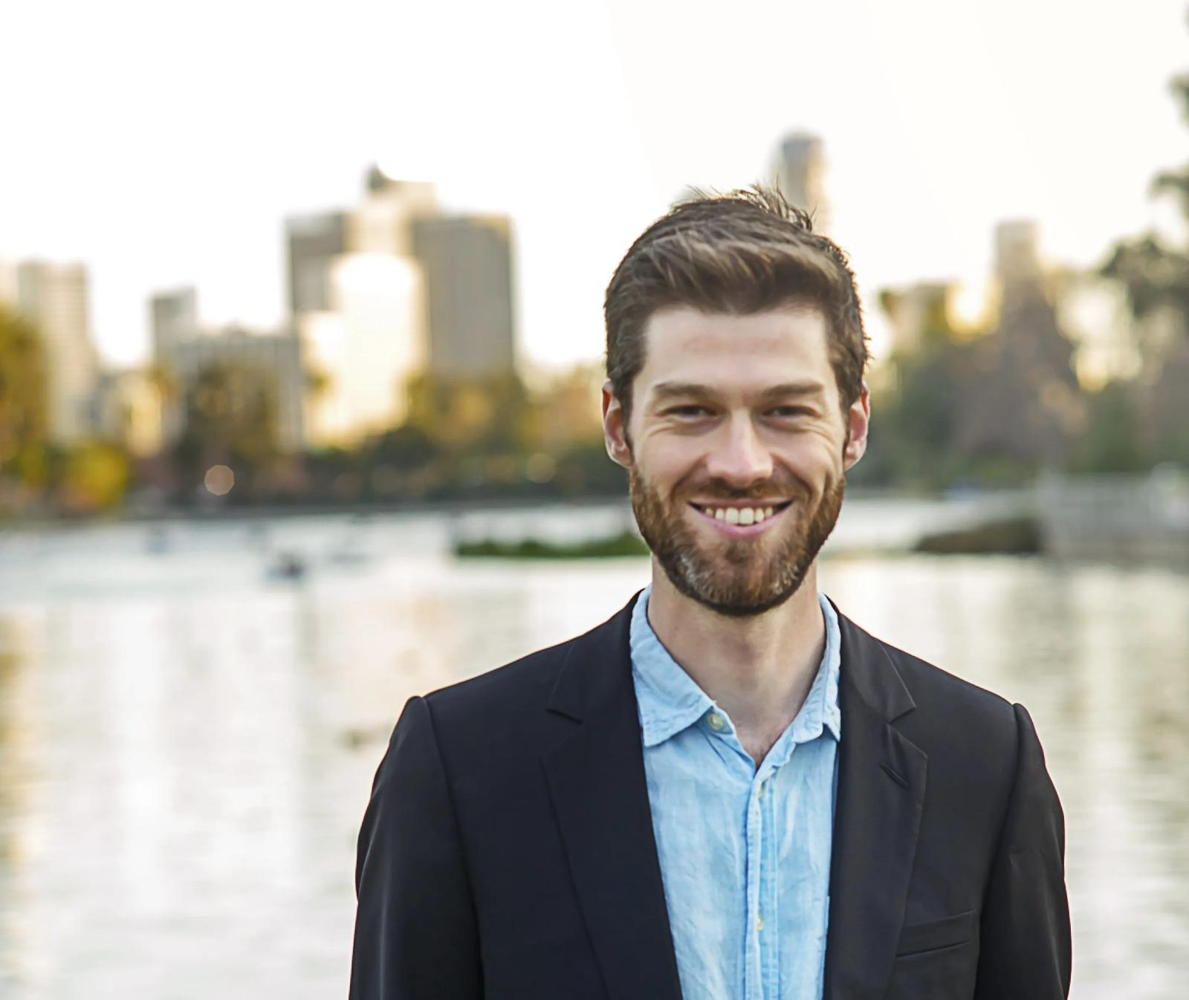
User Story
Tristan Blaine, whose age is 26 a California-based small business lawyer, is one of the millions of investors who engages in socially responsible investing.
“As an investor, I want my money to go to companies that believe in these basic values. I also believe that these practices are simply good for business, in the long run,” he says.
Blaine does his research by looking at companies that focus on green technologies, are working toward being carbon negative, or have a certified B-Corps status.
Notes:
He believes that everyone, including businesses, needs to work toward maximizing their positive impact.

Slide 5
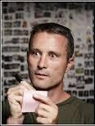
User Story
Simon Mainwaring, age 20 is a branding expert and author. He often explains to consumers how the business revolution will save the future.
He recommends moving personal investments and retirement funds to socially responsible investment funds (SRI) that invest in only corporations upholding high standards of behavior.
According to him, SRI funds usually produce returns comparable to, if not better than, several well-known traditional mutual funds.
Notes:
Harshal

Slide 6
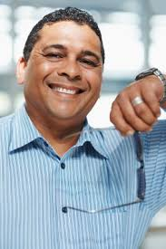
User Story
Tim Horton, age 50 is a social media lawyer who is always in support of businesses, particularly those that are ecologically friendly and support recyclable goods.
He is willing to Invest in businesses that strive to improve human well-being and increase economic efficiency while lowering environmental hazards.
Companies who provide products and services that assist economies in adapting to, solving, or mitigating the effects of important environmental and economic systemic concerns are encouraged to apply
Notes:
Additionally, he identifies green economy businesses with above-average development potential.

Slide 7
Customer Journey Map
Definition:
A customer journey map is a visual representation of a customer’s experience with your brand. These visuals tell a story about how a customer moves through each phase of interaction and experiences each phase.
Notes:
Farhan

Slide 8
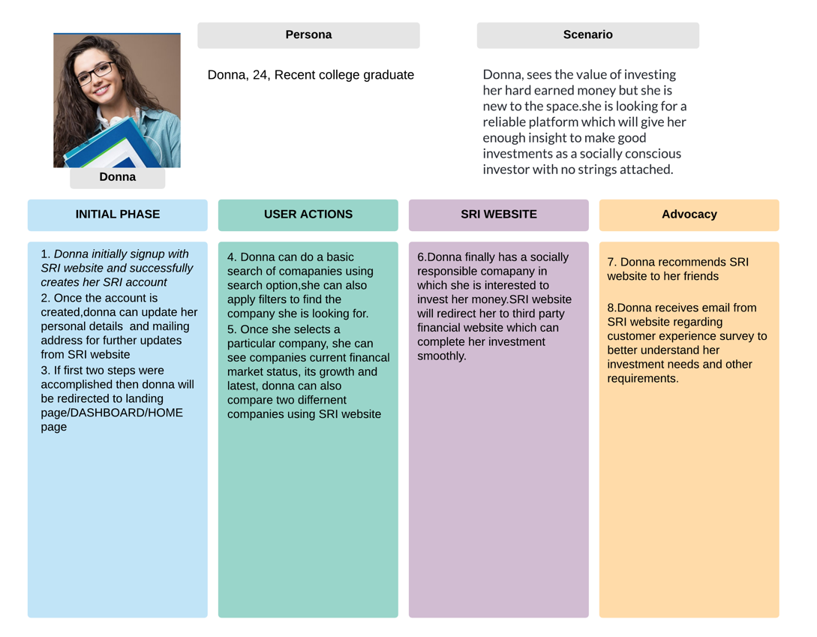
Customer Journey Map

Slide 9
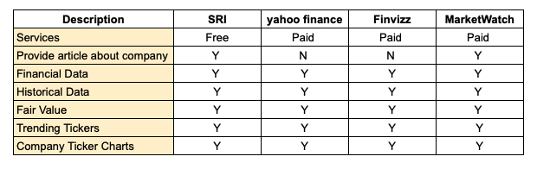
Competition Analysis

Slide 10
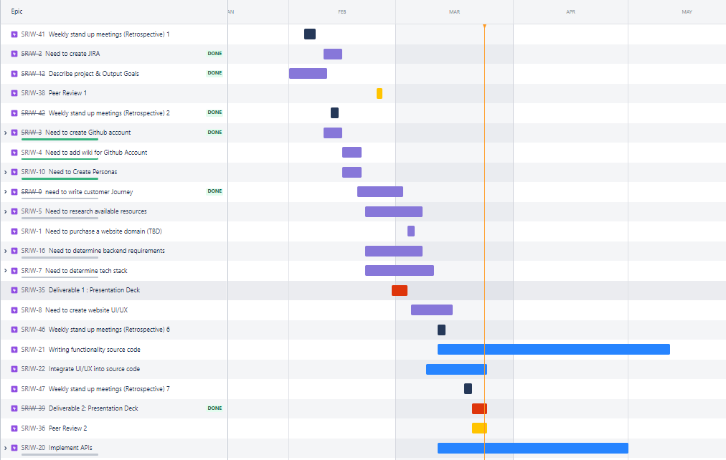
JIRA:
Notes:
Louis-Jacques

Slide 11
Product Backlog
# | Tasks | Features | Date | Priority
1 | Website Domain | Need to purchase a website domain | 03/17/2022 | Low
2 | Google Article | To find mechanism for generating articles | 03/17/2022 | Medium
3 | API for stock prices and companies | Integrate: Google Finance, Yahoo Finance, Vantage API | 03/17/2022 | High
4 | Write Pseudo code | Need to write algo and determine functionalities | 03/17/2022 | Medium

Slide 12
Sprint Backlog
Sprint Task | Module | Priority | Issues Encountered | Start Date | End Date | Status
Sprint 1 | Brainstorming | High | Team members had different challenges for different features | 02/15/2022 |  | In-Progress
Sprint 2 | Weekly standup meeting | Medium | Time management | 03/16/2022 | 03/16/22 | Incomplete

Slide 13
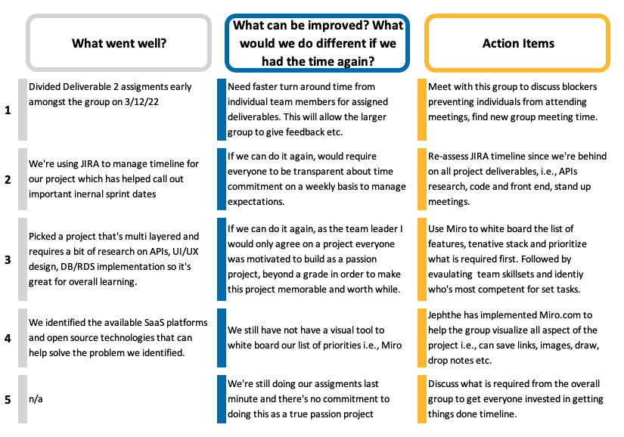

Retrospective: Deliverables 2
Notes:
Presented by Jephthé Louis-Jacques

Slide 14
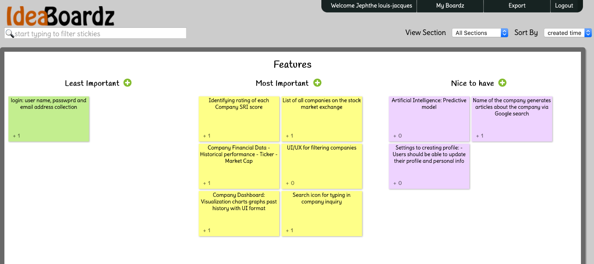
Features Consensus with Ideal Boardz
What are the most important features we should build for MVP?
Notes:
https://ideaboardz.com/for/Features/4398999

Slide 15
MVP
(Minimum Viable Product)
A minimum viable product is a version of product with just enough features to be usable by early customers who can then provide feedback for future product development.
What is our market ?
Market that we are targeting is the investment field, people nowadays are looking forward to invest their money rather than keeping it in the bank where it is depreciating. We are targeting the people that are looking for a reliable and trustable source which will guide them to invest in a firm where there investment will be safe and give decent returns.
What is our target audience?
Millennials and the Gen-z are facing the problem, taking myself as an example i want a trustable, reliable and a free source (as most of the source out there are paid.) which will help me to research about my investments and provide genuine information about the company that will keep my investments safe.

Slide 16
How are we resolving the problem?
We are solving the problem by providing the services for free and building the trust with the customer. We are building the trust with the customer by not tracking them and not storing their data and give them genuine results. As in today's era of internet people really care about their privacy and data.
Which problem is our MVP meant to solve?
To solve the problem of keeping their investment safe and all for free, by providing real-time data and a study about the companies revenue in the past years and whether the company is currently making profit in the running year which is directly related to it's stock price that will it fall or rise in future and prompting the customer whether their investment is safe or not.
Is there a place for our product in market?
Yes, as all the other services similar to our service is paid, we are selling our service for free and people want something which will provide a safe path to investment.

Slide 17
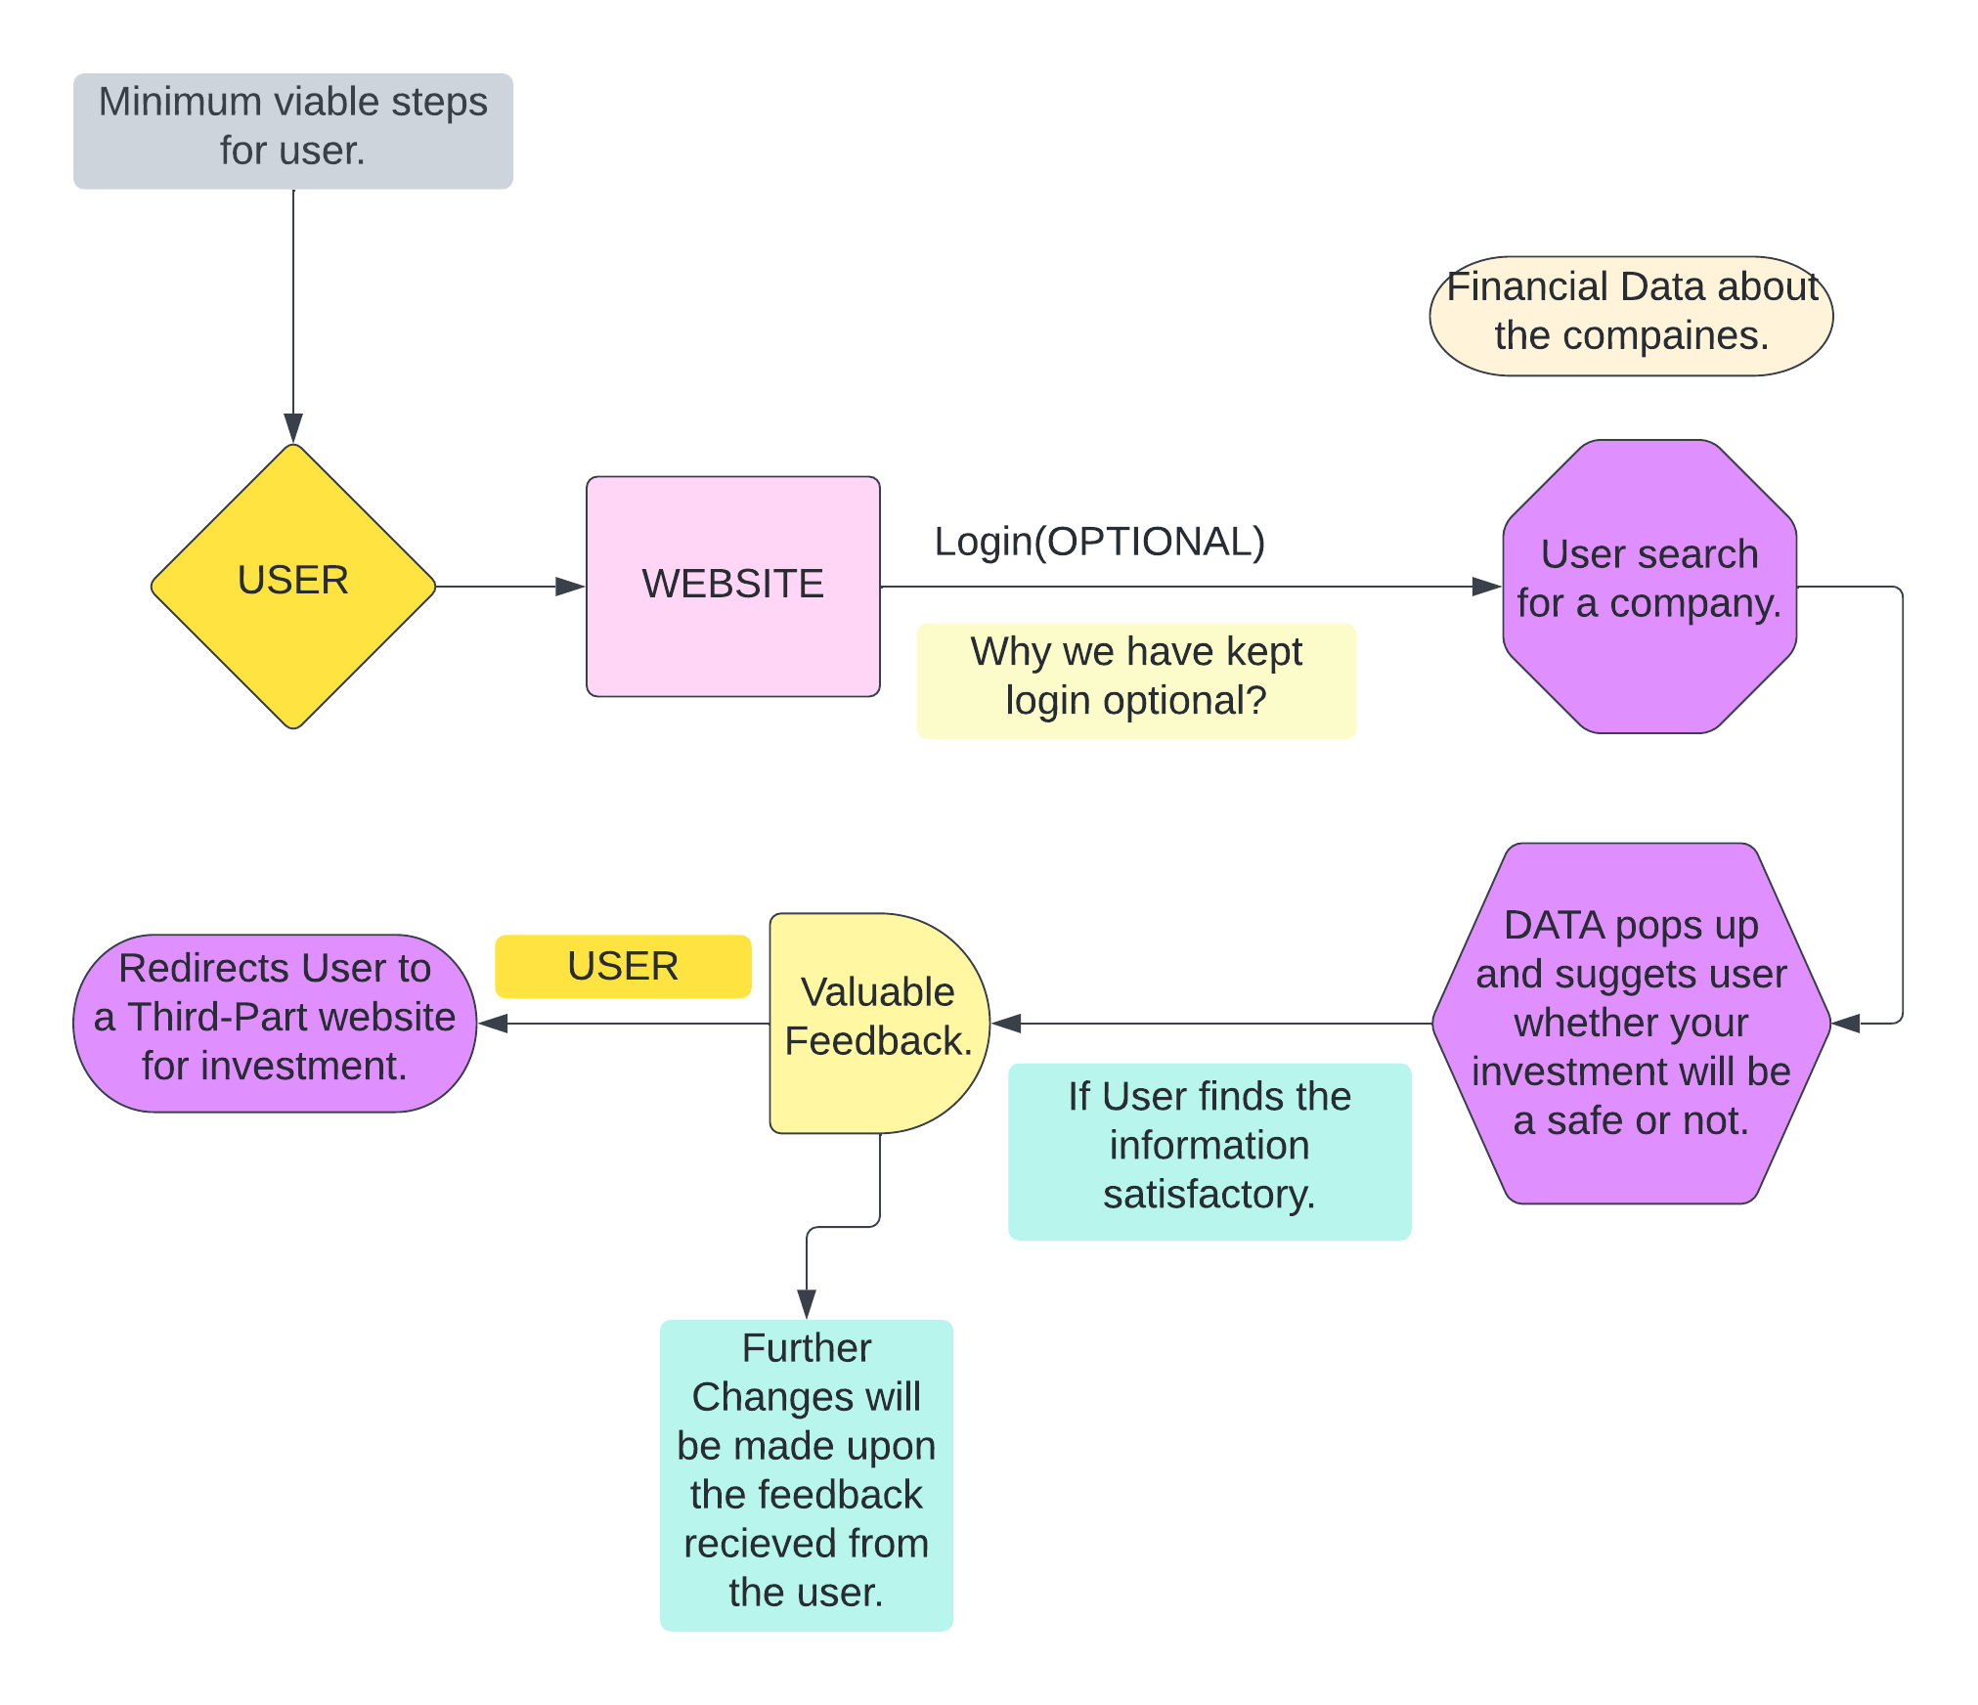
Minimum viable steps for user.

Slide 18
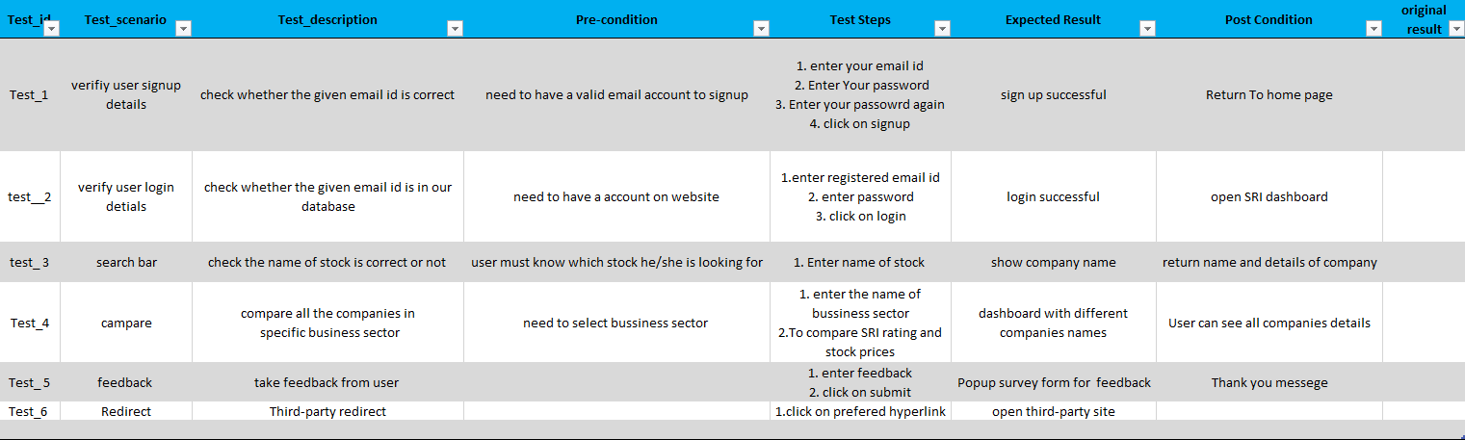
Test Cases

Slide 19
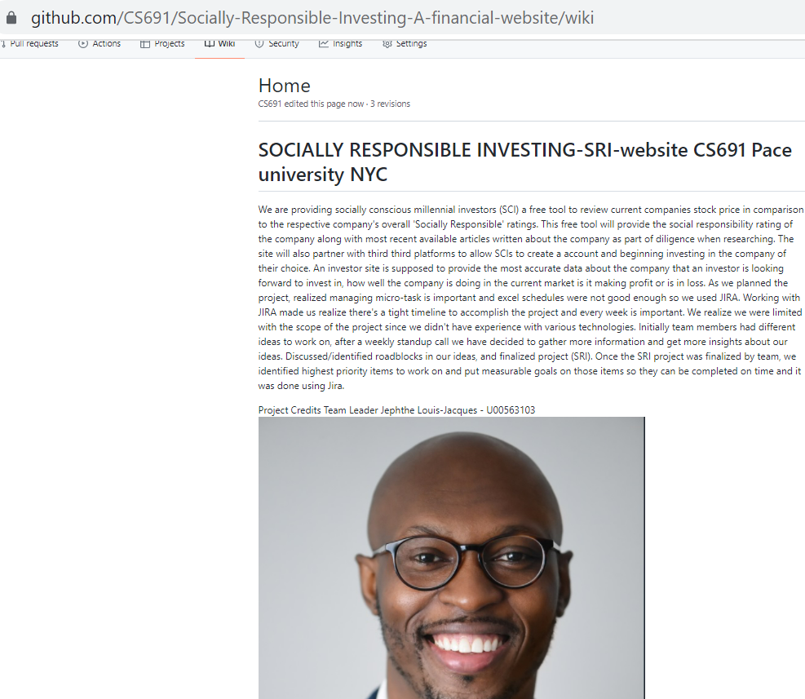
Github Wiki
Notes:
Kiran

Slide 20
THANK YOU!

